Slide 1
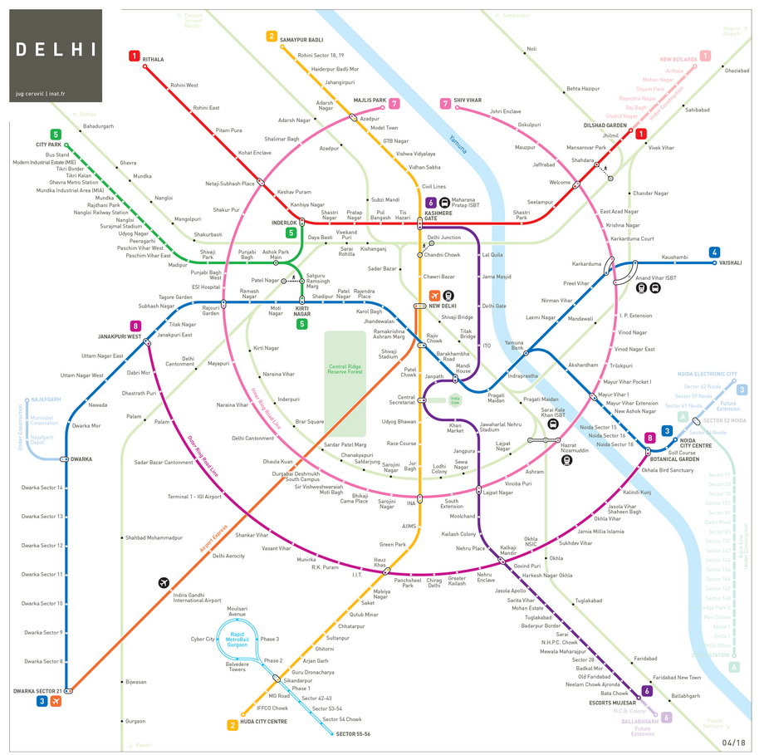
Battle Of Neighbourhoods (Delhi Metro Rail Corporation)

Slide 2
Introduction: Business Problem
In this project we will try to find an optimal location for a Cafeteria. Specifically, this report will be targeted to stakeholders interested in opening an Cafeteria in Delhi, India.
Since there are lots of Cafe's in Delhi we will try to detect locations that are not already crowded with self serving Cafeteria's. We are also particularly interested in all the areas within 500m radius of Metro Stations along Delhi Mtero Rail Corp. network. We would also prefer locations as close to Metro Station as possible, assuming that first two conditions are met.
We will use our data science powers to generate a few most promissing neighborhoods based on this criteria. Advantages of each area will then be clearly expressed so that best possible final location can be chosen by stakeholders.

Slide 3
Data
Based on definition of our problem, factors that will influence our decision are:
number of metro stations in DMRC network ( included Rapid Metro Stations)
number of existing Cafe/restaurants in the 500m radius of Metro Station (any type of Self Serving Restaurant/Cafe)
number of and distance to nearby Cafeteria in the neighborhood, if any
distance of neighborhood from Metro Stations
We decided to use regularly spaced grid of locations, centered around each Metro Station, to define our neighborhoods.
Following data sources will be needed to extract/generate the required information:
centers of candidate areas will be generated algorithmically and approximate addresses of centers of those areas will be obtained using Google Maps API reverse geocoding
number of restaurants and their type and location in every neighborhood will be obtained using Foursquare API
coordinate of Berlin center will be obtained using Google Maps API geocoding of well known Berlin location (Alexanderplatz)

Slide 4
Neighborhood Candidates
Let's create latitude & longitude coordinates for centroids of our candidate neighborhoods. We will create a grid of cells covering our area of interest which is aprox. 500 meters centered around each Metro Station of Delhi Metro.
Let's first find the Unique name of each Metro Station by Web Scraping the Metro Network Data from DMRC website using BeautifulSoup package and further Geo-Coding each using well known address and Google Maps geocoding API.

Slide 5
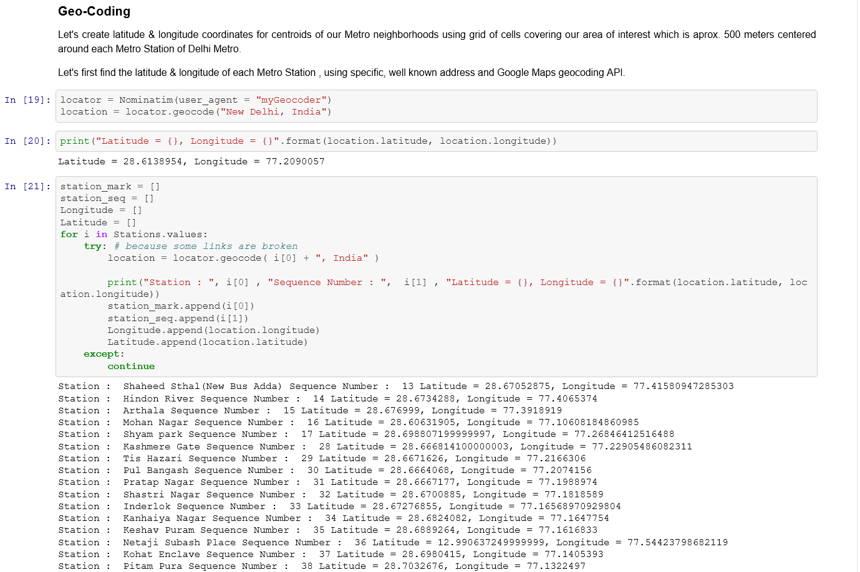
Geo-Coding using Foursquare API

Slide 6
Methodology
In this project we will direct our efforts on detecting areas along Delhi Metro Network that have low restaurant density, particularly those with low number of self serving Cafeteria's. We will limit our analysis to area ~500m around each Metro Station in DMRC network.
In first step we have collected the required data: location and type (category) of every venue within 500m from each Metro Station center . We have also identified all the existing Cafeteria's (according to Foursquare categorization).
Second step in our analysis will be calculation and exploration of 'Cafeteria density' across different Metro Stations of DMRC network - we will use folium map visualizations to identify a few promising areas close to Metro Stations with low number of Cafeteria's in general (and no Self Serving Cafeteria in vicinity) and focus our attention on those areas.
In third and final step we will focus on most promising areas and within those create clusters of locations that meet some basic requirements established in discussion with stakeholders: we will take into consideration locations with all the Venues/Restaurants in radius of 500 meters, and we want locations without much Cafe's in radius of 500 meters. We will present map of all such locations but also create clusters (using k-means clustering) of those locations to identify general zones / neighborhoods / addresses which should be a starting point for final 'street level' exploration and search for optimal venue location by stakeholders.

Slide 7
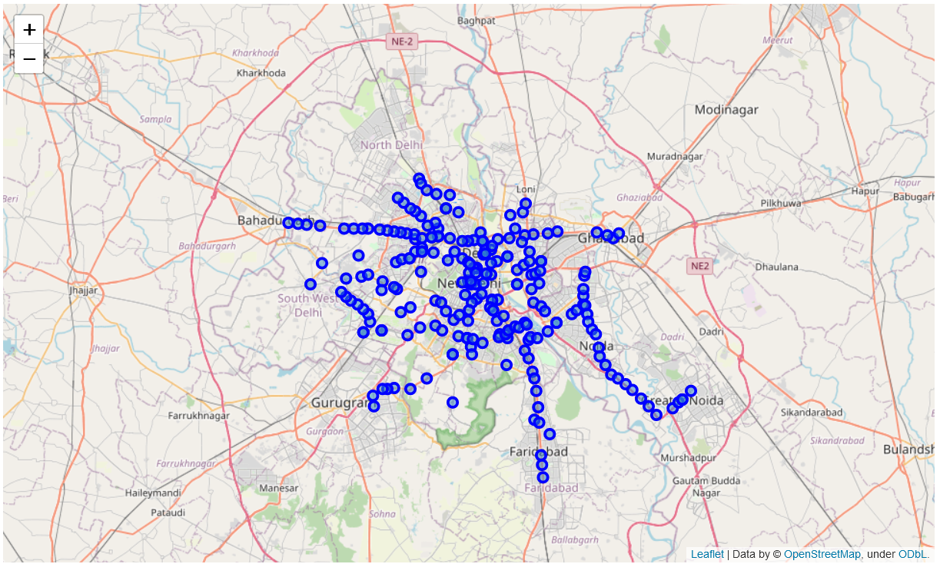
Map Visualization using Folium

Slide 8
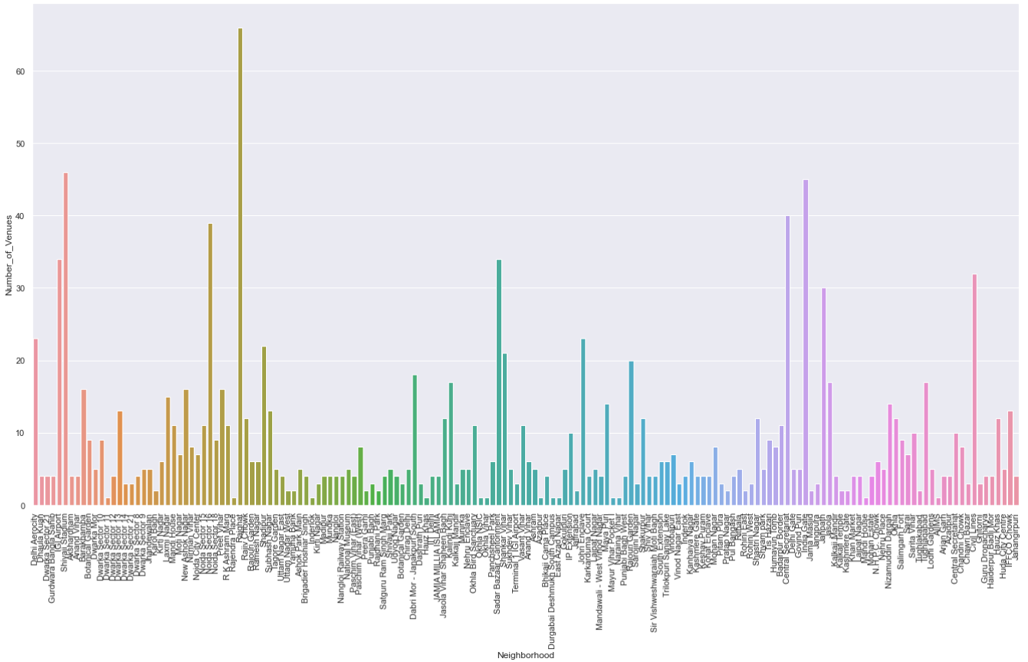
Foursquare Venues Collection

Slide 9
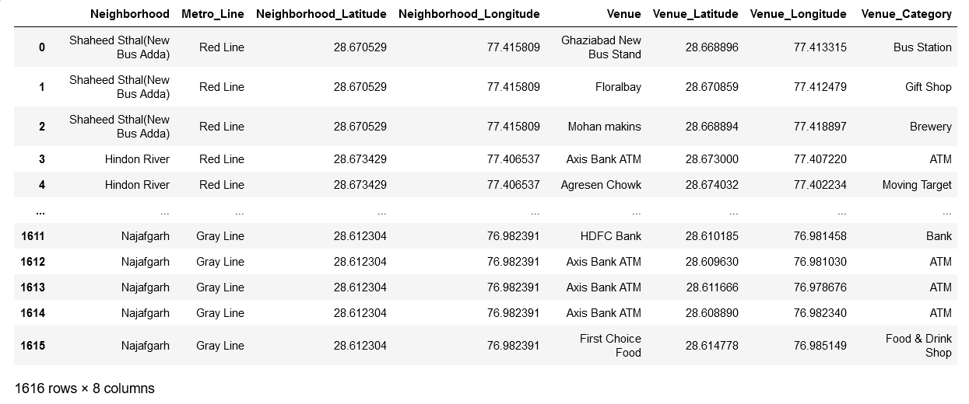
Neighbourhood Venues Data Collection

Slide 10
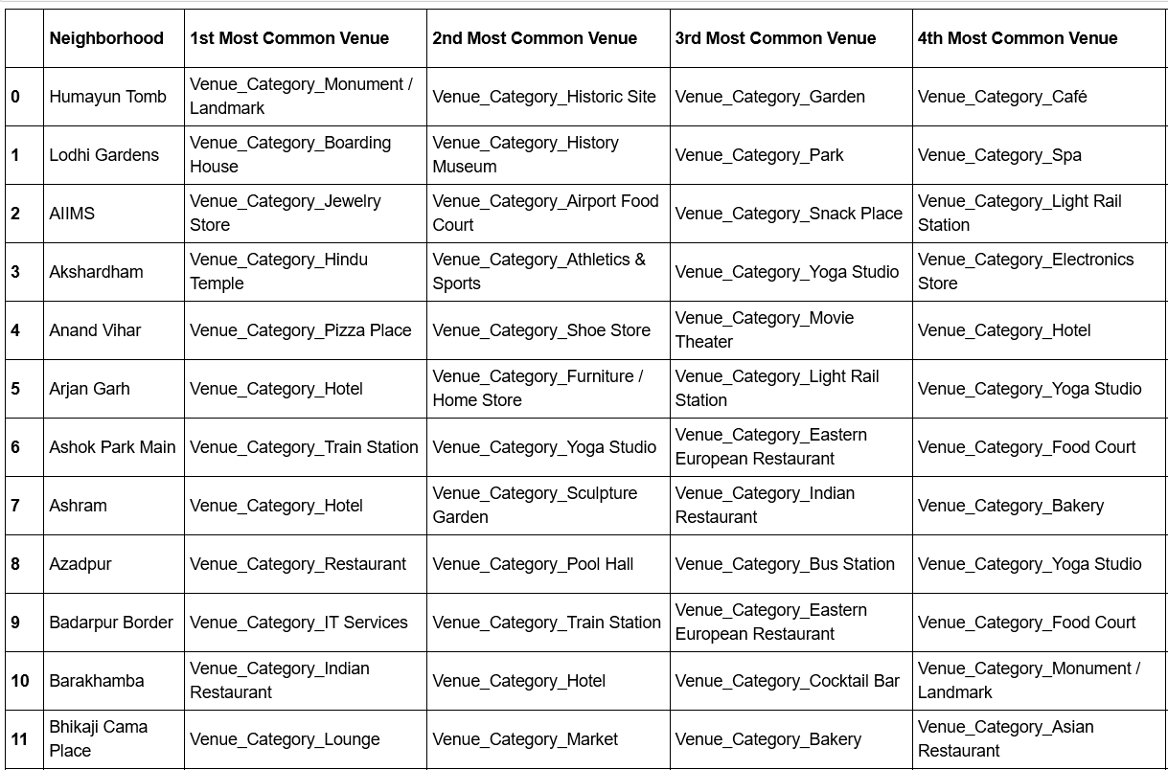
Neighbourhood’s Most Common Venues

Slide 11
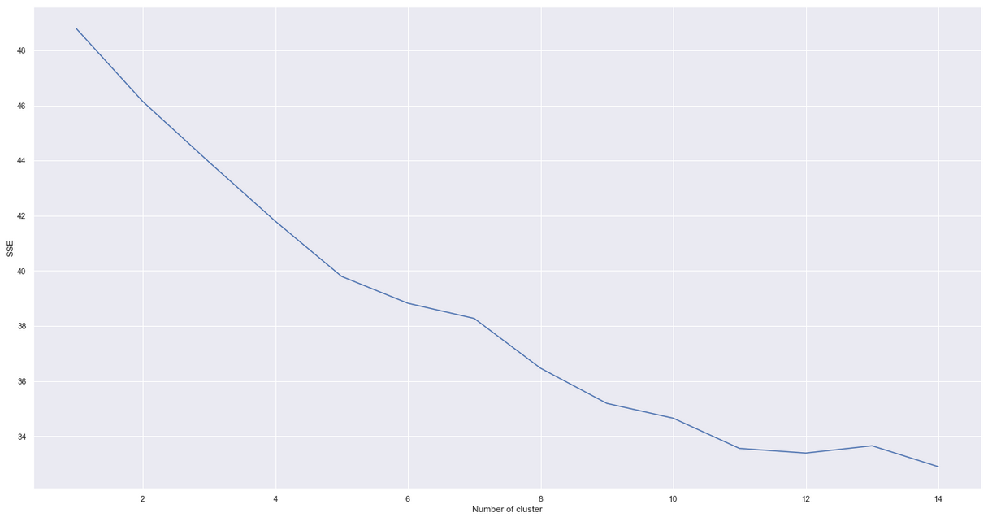
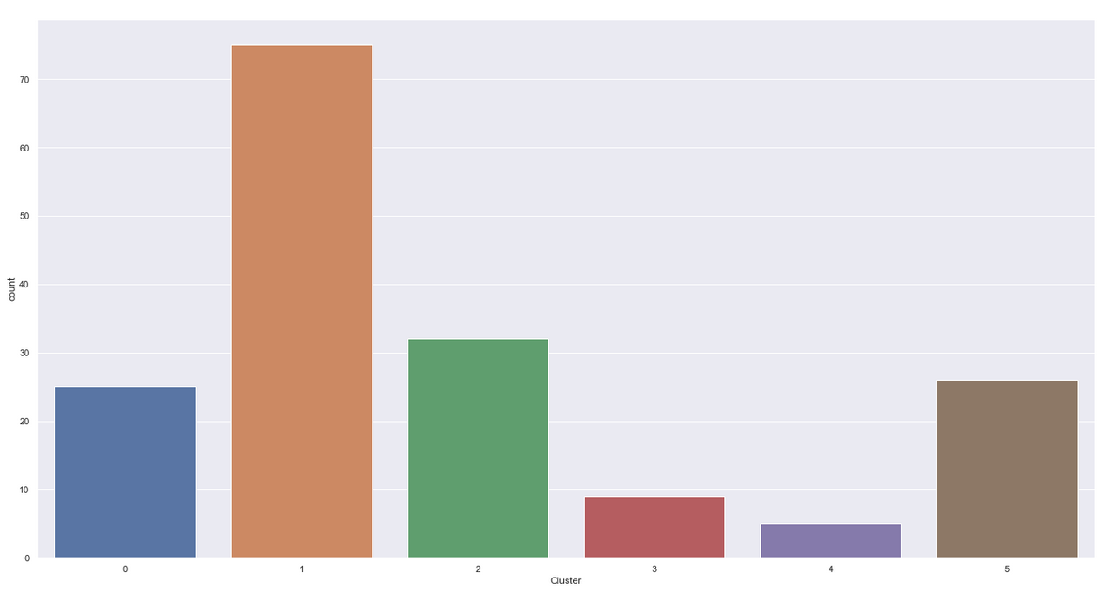
Clustering using K-Means

Slide 12
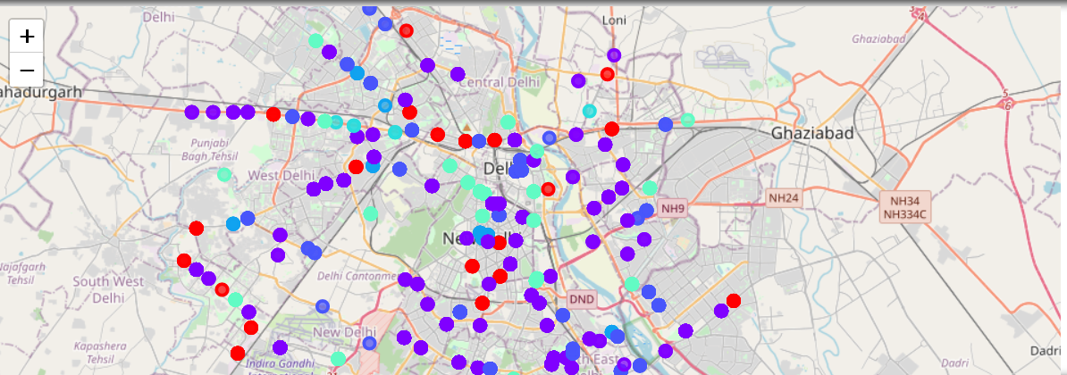
Cluster Visualization

Slide 13
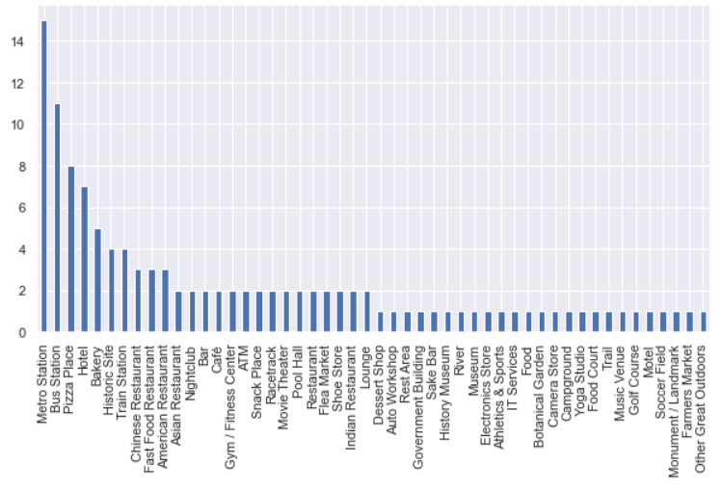
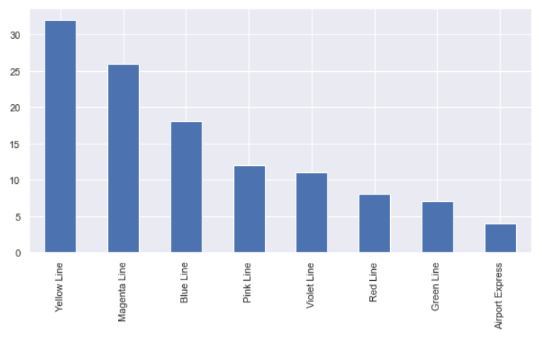
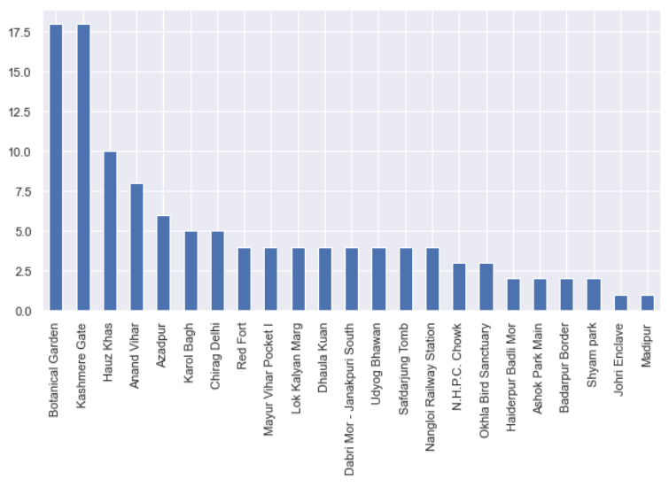
Cluster Interpretation
Locations Suggested from Cluster 1
(similar Analysis for each Cluster)

Slide 14
Results and Discussion
Our analysis shows that although there is a great number of restaurants/Cafe's in Delhi (~1800 in our initial area of interest which was whole DMRC network), there are pockets of low restaurant density fairly close to some Metro Stations. Highest concentration of Cafeteria's was detected in Cluster 0 and 2 along Blue , Yellow ,Violet and Magenta Line of DMRC, so we focused our attention to areas where Cafe intensity is comparatively low. Another Metro Line was identified as potentially interesting (Magenta_Line and Green Line), but our attention was focused on Cluster 1 which offer a combination of popularity among travellers, closeness to city center, strong socio-economic dynamics and a number of pockets of low Cafe density.
After directing our attention to this more narrow area of interest (covering cluster 1) we first created a dense grid of location candidates ; those locations are identified as Tagore Garden,India Gate,Kalkaji Mandir,AIIMS and Laxmi Nagar. These location candidates are our zones of interest which contain lowest number of existing Cafe's. Addresses of centers of those zones were also generated using reverse geocoding to be used as markers/starting points for more detailed local analysis based on other factors.
Result of all this is 6 zones containing largest number of potential new Cafe locations based on number of and distance to existing venues - both Self Serving Restaurants in general and Cafeteria particularly. This, of course, does not imply that those zones are actually optimal locations for a new Cafeteria! Purpose of this analysis was to only provide info on areas close to Metro Stations but not crowded with existing Self Serving Restaurants (particularly Cafe) - it is entirely possible that there is a very good reason for small number of restaurants in any of those areas, reasons which would make them unsuitable for a new restaurant regardless of lack of competition in the area. Recommended zones should therefore be considered only as a starting point for more detailed analysis which could eventually result in location which has not only no nearby competition but also other factors taken into account and all other relevant conditions met.

Slide 15
Conclusion
Purpose of this project was to identify Delhi areas close to DMRC Metro Stations with low number of Self Serving - Restaurants (particularly Cafeteria) in order to aid stakeholders in narrowing down the search for optimal location for a new Cafeteria. By calculating restaurant density distribution from Foursquare data we have first identified general boroughs that justify further analysis (Cluster 1 and 2), and then generated extensive collection of locations which satisfy some basic requirements regarding existing nearby restaurants. Clustering of those locations was then performed in order to create major zones of interest (containing greatest number of potential locations) and addresses of those zone centers were created to be used as starting points for final exploration by stakeholders.
Final decission on optimal Cafe location will be made by stakeholders based on specific characteristics of neighborhoods and locations in every recommended zone, taking into consideration additional factors like attractiveness of each location (proximity to park or water), levels of noise / proximity to major roads, real estate availability, prices, social and economic dynamics of every neighborhood etc.

